Slide 1
Algorithmic Bayesian Epistemology
Eric Neyman
January 24, 2024
Supervised by Tim Roughgarden

Slide 2
Outline
What is algorithmic Bayesian epistemology?
Technical content
  Incentivizing precise forecasts
  Arbitrage-free contract functions
  Quasi-arithmetic pooling
  Learning weights for logarithmic pooling
  Robust aggregation of substitutable signals
  When does agreement imply accuracy?
  Deductive circuit estimation

Slide 3
Outline
What is algorithmic Bayesian epistemology?
Technical content
  Incentivizing precise forecasts
  Arbitrage-free contract functions
  Quasi-arithmetic pooling
  Learning weights for logarithmic pooling
  Robust aggregation of substitutable signals
  When does agreement imply accuracy?
  Deductive circuit estimation
Conclusion: the most exciting questions in ABE
The blue chapters are my favorite contributions! They will be accompanied by “future directions” slides.

Slide 4
Outline
What is algorithmic Bayesian epistemology?
Technical content
  Incentivizing precise forecasts
  Arbitrage-free contract functions
  Quasi-arithmetic pooling
  Learning weights for logarithmic pooling
  Robust aggregation of substitutable signals
  When does agreement imply accuracy?
  Deductive circuit estimation
Conclusion: the most exciting questions in ABE

Slide 5
Bayesian epistemology
Epistemology: the study of knowledge and uncertainty
Bayesian epistemology: a formal approach to epistemology that interprets beliefs as subjective probabilities over outcomes
  Observer assigns probabilities to uncertain events and updates those probabilities in light of new evidence

Slide 6
The algorithmic lens
Many theoretical questions are optimization questions: what is the optimal solution to problem X?
Example: welfare-maximizing auctions
  Economist’s solution: VCG (find optimal allocation, charge bidders their externalities)
  Computer scientist’s complaint: this can’t be done efficiently!
    Algorithmic lens: how can you achieve approximately optimal welfare in polynomial computation + communication?
Instead of finding the optimal solution, looking for satisfactory solutions that adhere to real-world constraints
  Coined at Berkeley by members of Theory of Computing research group c. 2000

Slide 7
Algorithmic Bayesian epistemology (ABE)
The application of the algorithmic lens to Bayesian epistemology
A question belongs to the field of algorithmic Bayesian epistemology (ABE) if it involves reasoning about uncertainty from a Bayesian perspective, but under constraints that prevent complete assimilation of all existing information.

Slide 8
What kinds of constraints?
Computational constraints
  Approximating Bayesian inference
Informational constraints
  Forecast aggregation under incomplete information
Communication constraints
  Agreement protocols
Strategic constraints
  Prediction markets

Slide 9
Outline
What is algorithmic Bayesian epistemology?
Technical content
  Incentivizing precise forecasts
  Arbitrage-free contract functions
  Quasi-arithmetic pooling
  Learning weights for logarithmic pooling
  Robust aggregation of substitutable signals
  When does agreement imply accuracy?
  Deductive circuit estimation
Conclusion: the most exciting questions in ABE

Slide 10
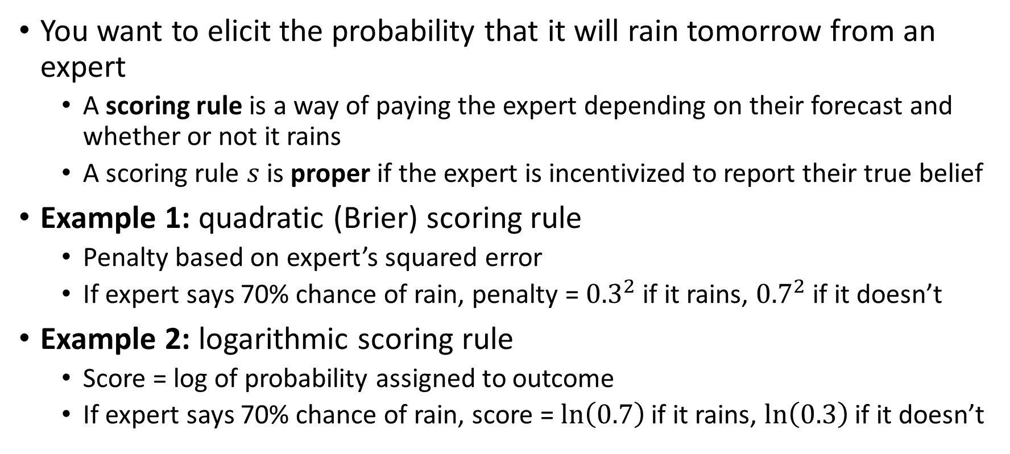
Background on proper scoring rules
You want to elicit the probability that it will rain tomorrow from an expert
  A scoring rule is a way of paying the expert depending on their forecast and whether or not it rains
  A scoring rule $s$ is proper if the expert is incentivized to report their true belief
Example 1: quadratic (Brier) scoring rule
  Penalty based on expert’s squared error
  If expert says 70% chance of rain, penalty = ${0.3}^{2}$ if it rains, ${0.7}^{2}$ if it doesn’t
Example 2: logarithmic scoring rule
  Score = log of probability assigned to outcome
  If expert says 70% chance of rain, score = $\ln\left(0.7\right)$ if it rains, $\ln\left(0.3\right)$ if it doesn’t

Slide 11
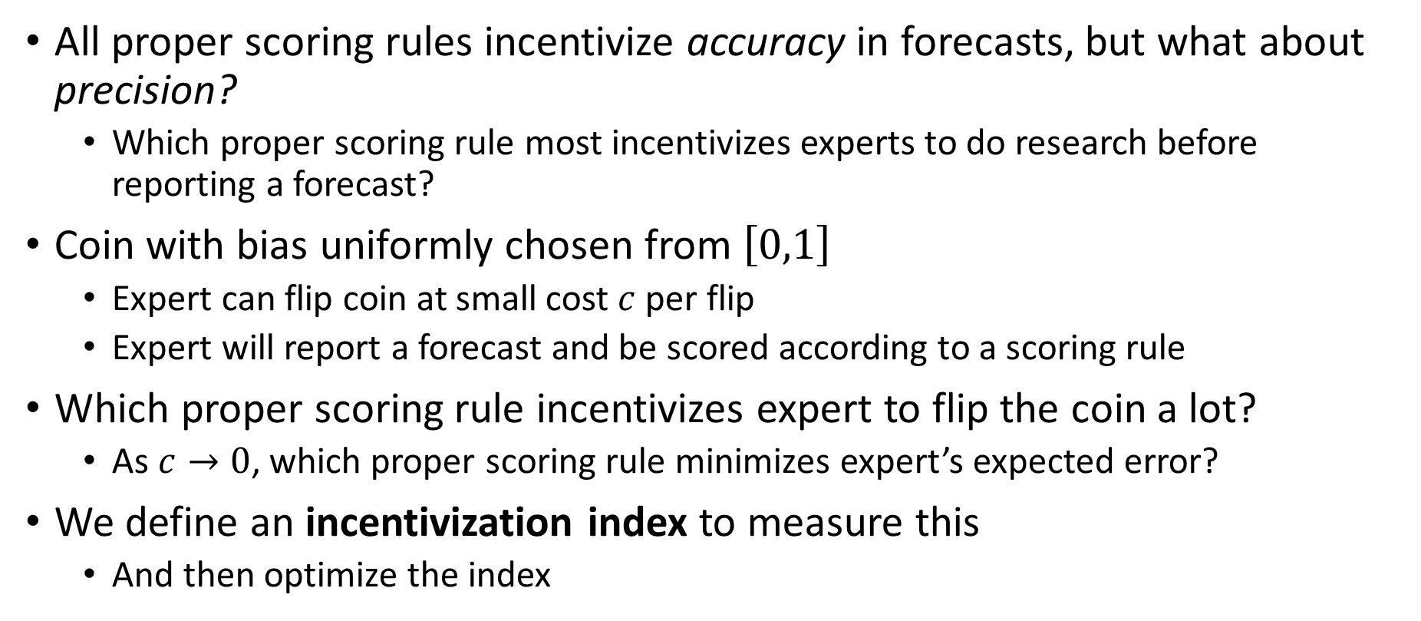
Incentivizing precision (1/2)
(Joint work with George Noarov and Matt Weinberg)
All proper scoring rules incentivize accuracy in forecasts, but what about precision?
  Which proper scoring rule most incentivizes experts to do research before reporting a forecast?
Coin with bias uniformly chosen from $\left[0,1\right]$
  Expert can flip coin at small cost $c$ per flip
  Expert will report a forecast and be scored according to a scoring rule
Which proper scoring rule incentivizes expert to flip the coin a lot?
  As $c→0$, which proper scoring rule minimizes expert’s expected error?
We define an incentivization index to measure this
  And then optimize the index

Slide 12
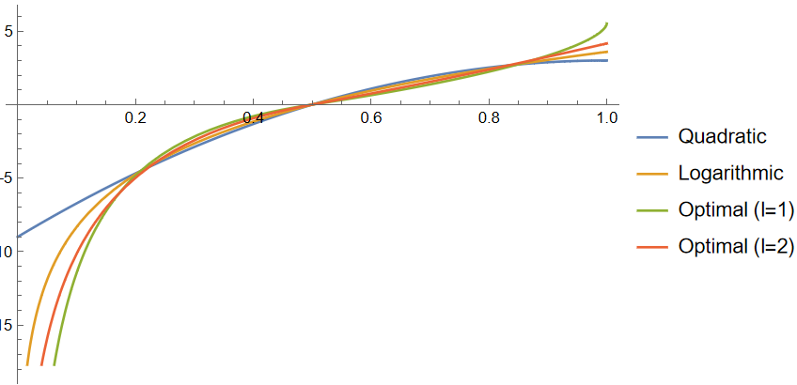
Incentivizing precision (2/2)
(Joint work with George Noarov and Matt Weinberg)
Quadratic and logarithmic scoring rules, together with optimal scoring rules for minimizing expected absolute error and squared error

Slide 13
Outline
What is algorithmic Bayesian epistemology?
Technical content
  Incentivizing precise forecasts
  Arbitrage-free contract functions
  Quasi-arithmetic pooling
  Learning weights for logarithmic pooling
  Robust aggregation of substitutable signals
  When does agreement imply accuracy?
  Deductive circuit estimation
Conclusion: the most exciting questions in ABE

Slide 14
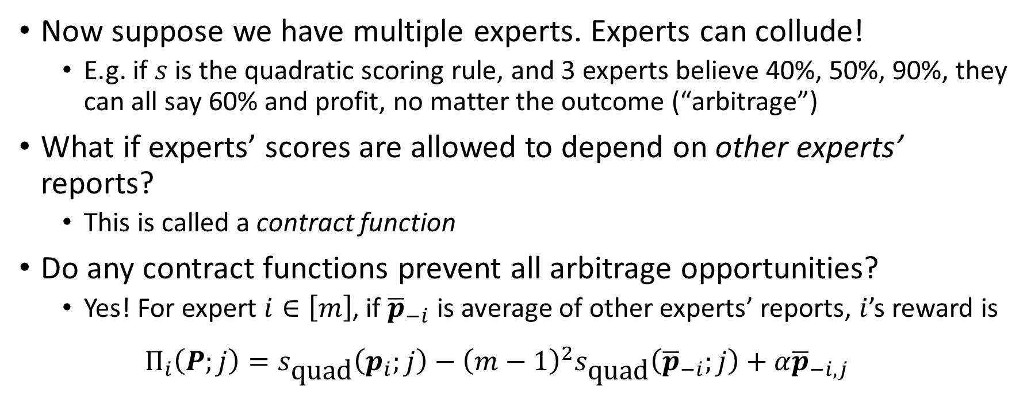
Arbitrage-free contract functions
(Joint work with Tim Roughgarden)
Now suppose we have multiple experts. Experts can collude!
  E.g. if $s$ is the quadratic scoring rule, and 3 experts believe 40%, 50%, 90%, they can all say 60% and profit, no matter the outcome (“arbitrage”)
What if experts’ scores are allowed to depend on other experts’ reports?
  This is called a contract function
Do any contract functions prevent all arbitrage opportunities?
  Yes! For expert $i∈\left[m\right]$, if ${\overline{p}}_{−i}$ is average of other experts’ reports, $i$’s reward is
  $$Π_{i}\left(P;j\right)=s_{\text{quad}}\left(p_{i};j\right)−{\left(m−1\right)}^{2}s_{\text{quad}}\left({\overline{p}}_{−i};j\right)+α{\overline{p}}_{−i,j}$$
Total reward depends only on average of all reports
Total score is lower for some outcome

Slide 15
Outline
What is algorithmic Bayesian epistemology?
Technical content
  Incentivizing precise forecasts
  Arbitrage-free contract functions
  Quasi-arithmetic pooling
  Learning weights for logarithmic pooling
  Robust aggregation of substitutable signals
  When does agreement imply accuracy?
  Deductive circuit estimation
Conclusion: the most exciting questions in ABE

Slide 16
Quasi-arithmetic pooling (1/2)
(Joint work with Tim Roughgarden)
After eliciting forecasts from multiple experts, how should the aggregator combine them?
  Intuition: should depend on scoring rule. Different scoring rules incentivize precision in different ways, e.g. log score incentivizes precision near extreme probabilities (compared to quadratic score).
We define an aggregation method called quasi-arithmetic (QA) pooling (with respect to a given proper scoring rule) that takes this into account
  QA pooling averages forecasts based on the experts’ preferences over outcomes (induced by the scoring rule)

Slide 17
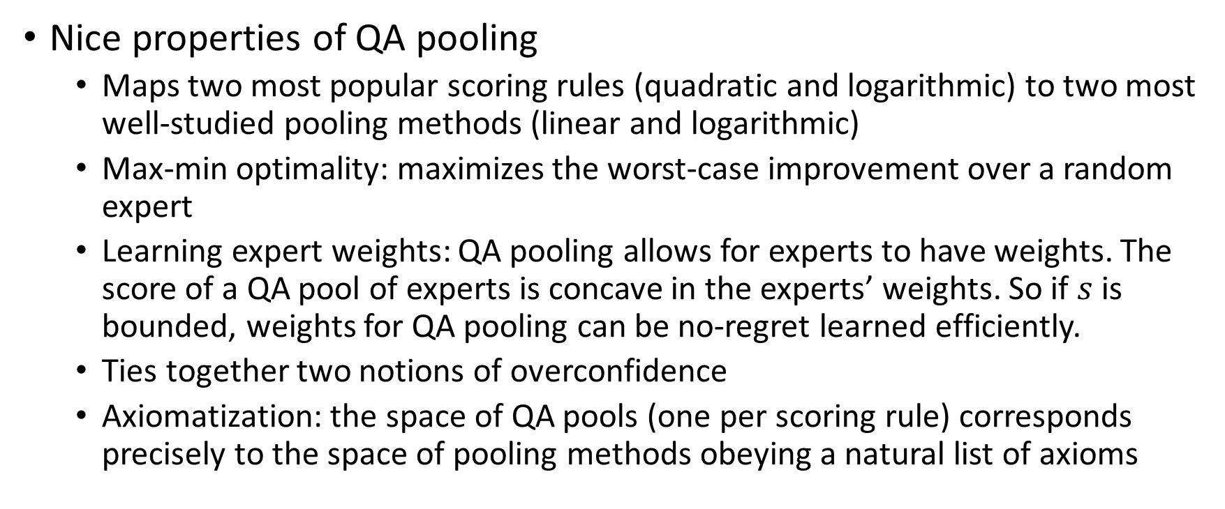
Quasi-arithmetic pooling (2/2)
(Joint work with Tim Roughgarden)
Nice properties of QA pooling
  Maps two most popular scoring rules (quadratic and logarithmic) to two most well-studied pooling methods (linear and logarithmic)
  Max-min optimality: maximizes the worst-case improvement over a random expert
  Learning expert weights: QA pooling allows for experts to have weights. The score of a QA pool of experts is concave in the experts’ weights. So if $s$ is bounded, weights for QA pooling can be no-regret learned efficiently.
  Ties together two notions of overconfidence
  Axiomatization: the space of QA pools (one per scoring rule) corresponds precisely to the space of pooling methods obeying a natural list of axioms

Slide 18
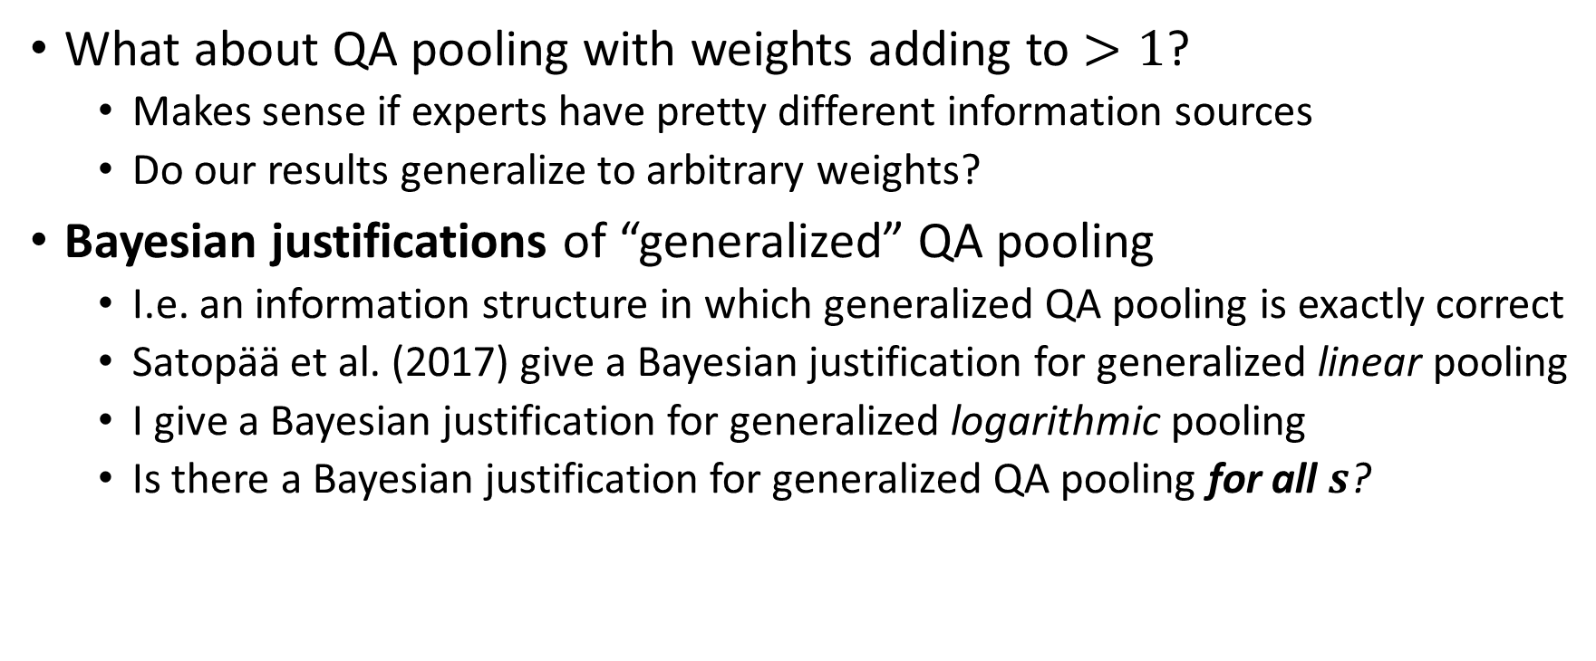
QA pooling: Future directions
What about QA pooling with weights adding to $>1$?
  Makes sense if experts have pretty different information sources
  Do our results generalize to arbitrary weights?
Bayesian justifications of “generalized” QA pooling
  I.e. an information structure in which generalized QA pooling is exactly correct
  Satopää et al. (2017) give a Bayesian justification for generalized linear pooling
  I give a Bayesian justification for generalized logarithmic pooling
  Is there a Bayesian justification for generalized QA pooling for all $s$?

Slide 19
Outline
What is algorithmic Bayesian epistemology?
Technical content
  Incentivizing precise forecasts
  Arbitrage-free contract functions
  Quasi-arithmetic pooling
  Learning weights for logarithmic pooling
  Robust aggregation of substitutable signals
  When does agreement imply accuracy?
  Deductive circuit estimation
Conclusion: the most exciting questions in ABE

Slide 20
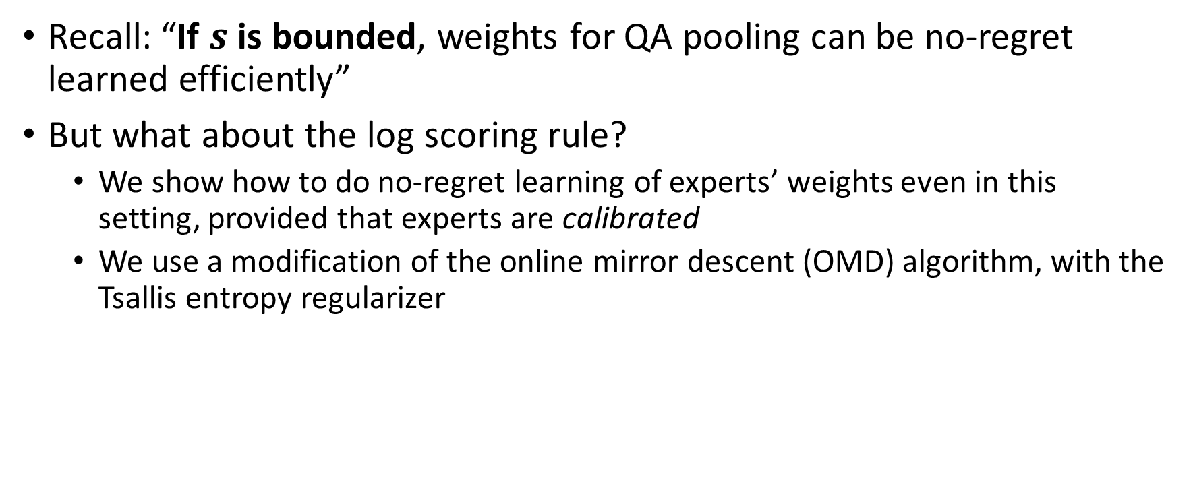
Learning weights for log pooling
(Joint work with Tim Roughgarden)
Recall: “If $s$ is bounded, weights for QA pooling can be no-regret learned efficiently”
But what about the log scoring rule?
  We show how to do no-regret learning of experts’ weights even in this setting, provided that experts are calibrated
  We use a modification of the online mirror descent (OMD) algorithm, with the Tsallis entropy regularizer

Slide 21
Outline
What is algorithmic Bayesian epistemology?
Technical content
  Incentivizing precise forecasts
  Arbitrage-free contract functions
  Quasi-arithmetic pooling
  Learning weights for logarithmic pooling
  Robust aggregation of substitutable signals
  When does agreement imply accuracy?
  Deductive circuit estimation
Conclusion: the most exciting questions in ABE

Slide 22
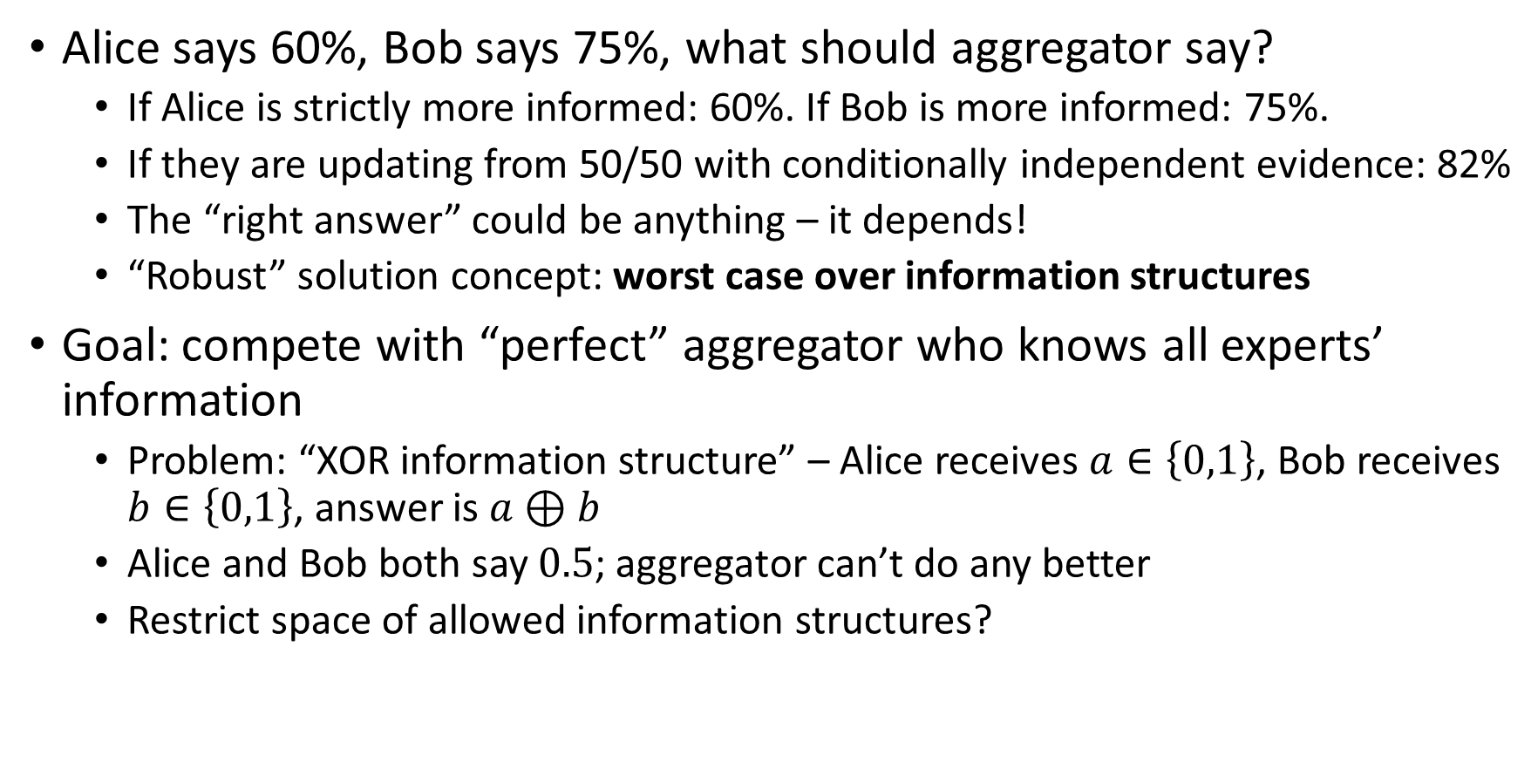
Robust aggregation of substitutable signals (1/3)
(Joint work with Tim Roughgarden)
Alice says 60%, Bob says 75%, what should aggregator say?
  If Alice is strictly more informed: 60%. If Bob is more informed: 75%.
  If they are updating from 50/50 with conditionally independent evidence: 82%
  The “right answer” could be anything – it depends!
  “Robust” solution concept: worst case over information structures
Goal: compete with “perfect” aggregator who knows all experts’ information
  Problem: “XOR information structure” – Alice receives $a∈\left\{0,1\right\}$, Bob receives $b∈\left\{0,1\right\}$, answer is $a⊕b$
  Alice and Bob both say $0.5$; aggregator can’t do any better
  Restrict space of allowed information structures?

Slide 23
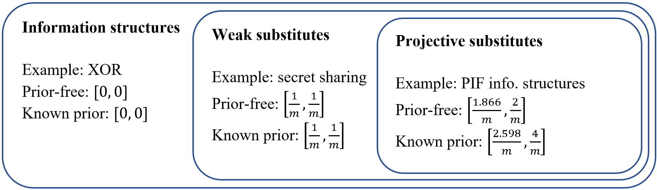
Robust aggregation of substitutable signals (2/3)
(Joint work with Tim Roughgarden)
We explore informational substitutes (roughly: experts’ information is substitutable rather than complementary)
  Standard notion: weak substitutes (Chen & Waggoner, 2016)
  To get nontrivial results, we give a stronger notion: projective substitutes
Our bounds on what approximation guarantees are attainable (m = # experts)

Slide 24
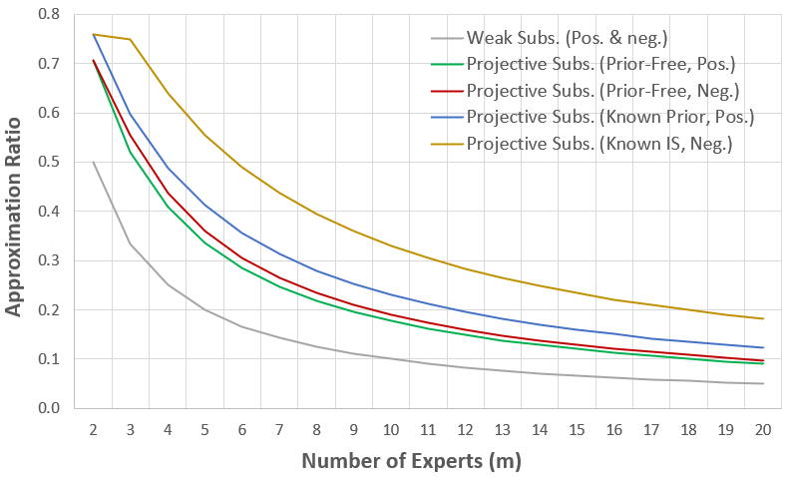
Robust aggregation of substitutable signals (3/3)
(Joint work with Tim Roughgarden)

Slide 25
Robust aggregation: Future directions
Generalizing robust aggregation results beyond squared error
  E.g. KL divergence (more appropriate for probabilistic forecasts)
“Exploring the playground” of robust aggregation
  Which loss function?
  Assumptions about information structure?
  What does the aggregator know?
  What does the aggregator learn from the experts?
  Experts truthful or strategic?
  Benchmark?

Slide 26
Outline
What is algorithmic Bayesian epistemology?
Technical content
  Incentivizing precise forecasts
  Arbitrage-free contract functions
  Quasi-arithmetic pooling
  Learning weights for logarithmic pooling
  Robust aggregation of substitutable signals
  When does agreement imply accuracy?
  Deductive circuit estimation
Conclusion: the most exciting questions in ABE

Slide 27
Does agreement imply accuracy?
(Joint work with Raf Frongillo and Bo Waggoner)
Alice and Bob have different information, leading to different beliefs
Can efficiently exchange information in order to reach agreement?
  Yes! (Aaronson 2004)
  But the agreed-upon value might not be accurate (might be different from their belief if they exchanged all information)
Are there natural sufficient conditions under which agreement implies accuracy?
  Yes! A (different) notion of informational substitutes

Slide 28
Outline
What is algorithmic Bayesian epistemology?
Technical content
  Incentivizing precise forecasts
  Arbitrage-free contract functions
  Quasi-arithmetic pooling
  Learning weights for logarithmic pooling
  Robust aggregation of substitutable signals
  When does agreement imply accuracy?
  Deductive circuit estimation
Conclusion: the most exciting questions in ABE

Slide 29
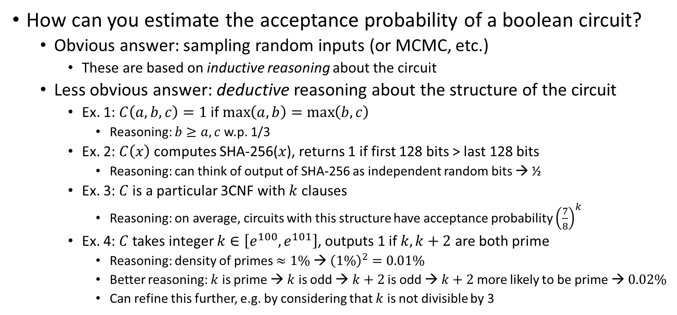
Deductive circuit estimation (1/3)
(Joint work with Paul Christiano, Jacob Hilton, Václav Rozhoň, and Mark Xu)
How can you estimate the acceptance probability of a boolean circuit?
  Obvious answer: sampling random inputs (or MCMC, etc.)
    These are based on inductive reasoning about the circuit
  Less obvious answer: deductive reasoning about the structure of the circuit
    Ex. 1: $C\left(a,b,c\right)=1$ if $\max\left(a,b\right)=\max\left(b,c\right)$
      Reasoning: $b≥a,c$ w.p. 1/3
    Ex. 2: $C\left(x\right)$ computes SHA-256($x$), returns 1 if first 128 bits > last 128 bits
      Reasoning: can think of output of SHA-256 as independent random bits → ½
    Ex. 3: $C$ is a particular 3CNF with $k$ clauses
      Reasoning: on average, circuits with this structure have acceptance probability ${\left(\frac{7}{8}\right)}^{k}$
    Ex. 4: $C$ takes integer $k∈\left[e^{100},e^{101}\right]$, outputs 1 if $k, k+2$ are both prime
      Reasoning: density of primes $≈1\%$ → ${\left(1\%\right)}^{2}=0.01\%$
      Better reasoning: $k$ is prime → $k$ is odd → $k+2$ is odd → $k+2$ more likely to be prime → $0.02\%$
      Can refine this further, e.g. by considering that $k$ is not divisible by 3

Slide 30
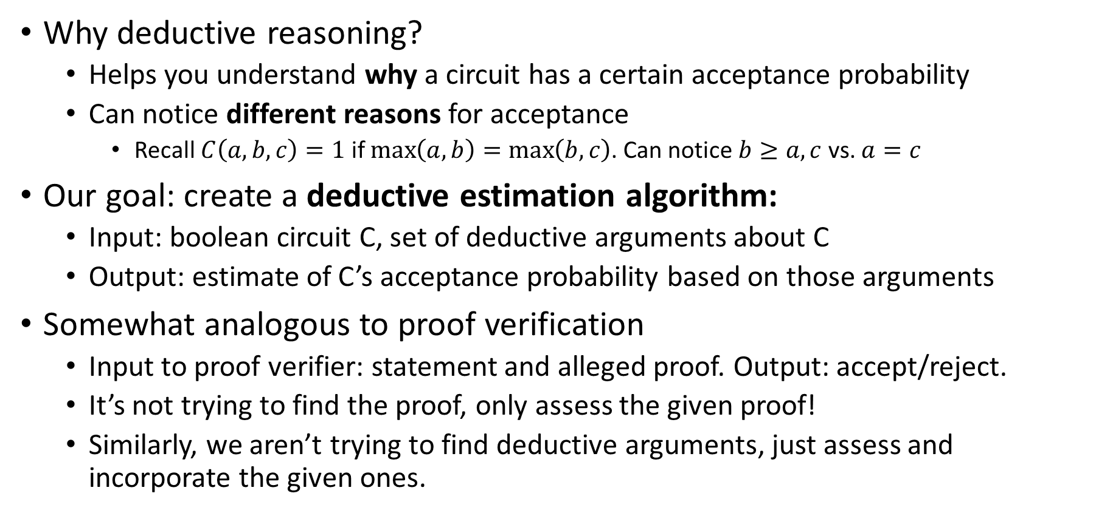
Deductive circuit estimation (2/3)
(Joint work with Paul Christiano, Jacob Hilton, Václav Rozhoň, and Mark Xu)
Why deductive reasoning?
  Helps you understand why a circuit has a certain acceptance probability
  Can notice different reasons for acceptance
    Recall $C\left(a,b,c\right)=1$ if $\max\left(a,b\right)=\max\left(b,c\right)$. Can notice $b≥a,c$ vs. $a=c$
Our goal: create a deductive estimation algorithm:
  Input: boolean circuit C, set of deductive arguments about C
  Output: estimate of C’s acceptance probability based on those arguments
Somewhat analogous to proof verification
  Input to proof verifier: statement and alleged proof. Output: accept/reject.
  It’s not trying to find the proof, only assess the given proof!
  Similarly, we aren’t trying to find deductive arguments, just assess and incorporate the given ones.

Slide 31
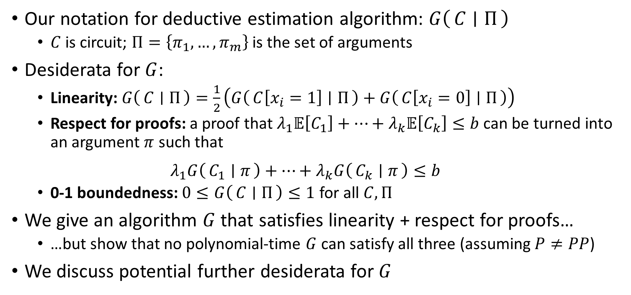
Deductive circuit estimation (3/3)
(Joint work with Paul Christiano, Jacob Hilton, Václav Rozhoň, and Mark Xu)
Our notation for deductive estimation algorithm: $G\left(C ∣ Π\right)$
  $C$ is circuit; $Π=\left\{π_{1},…,π_{m}\right\}$ is the set of arguments
Desiderata for $G$:
  Linearity: $G\left(C ∣ Π\right)=\frac{1}{2}\left(G\left(C\left[x_{i}=1\right] ∣ Π\right)+G\left(C\left[x_{i}=0\right] ∣ Π\right)\right)$
  Respect for proofs: a proof that $λ_{1}𝔼\left[C_{1}\right]+…+λ_{k}𝔼\left[C_{k}\right]≤b$ can be turned into an argument $π$ such that
  $$λ_{1}G\left(C_{1} ∣ π\right)+…+λ_{k}G\left(C_{k} ∣ π\right)≤b$$
  0-1 boundedness: $0≤G\left(C ∣ Π\right)≤1$ for all $C,Π$
We give an algorithm $G$ that satisfies linearity + respect for proofs…
  …but show that no polynomial-time $G$ can satisfy all three (assuming $P≠PP$)
We discuss potential further desiderata for $G$

Slide 32
Deductive circuit estimation: Future directions
Design a good deductive estimation algorithm!
  Figure out what “good” means (state some formal desiderata)
  Find an algorithm that satisfies those desiderata
I find this problem compelling for two reasons
  Seems like a fundamental theory problem (understanding and formalizing deductive argumentation)
  Potentially useful for the AI alignment problem

Slide 33
Outline
What is algorithmic Bayesian epistemology?
Technical content
  Incentivizing precise forecasts
  Arbitrage-free contract functions
  Quasi-arithmetic pooling
  Learning weights for logarithmic pooling
  Robust aggregation of substitutable signals
  When does agreement imply accuracy?
  Deductive circuit estimation
Conclusion: the most exciting questions in ABE

Slide 34
Conclusion: The most exciting questions in ABE
I’ve given three highlights:
  Finding Bayesian justifications for generalized QA pooling
  Further investigating robust aggregation (e.g. w.r.t. KL divergence)
  Finding a good deductive circuit estimation algorithm
Some other exciting directions:
  Sophisticated Bayesian models for forecast aggregation
  Wagering mechanisms that produce good aggregate forecasts
And many more!

Slide 35
Thank you!
My advisor, Tim Roughgarden
My undergraduate mentor, Matt Weinberg
My research collaborators: Paul Christiano, Raf Frongillo, Jacob Hilton, George Noarov, Václav Rozhoň, Bo Waggoner, Mark Xu
My friends, family, and communities

